Slide 1
NLAIFGML
Authors: Abel, Beyza, Edward, Ryan

Slide 2
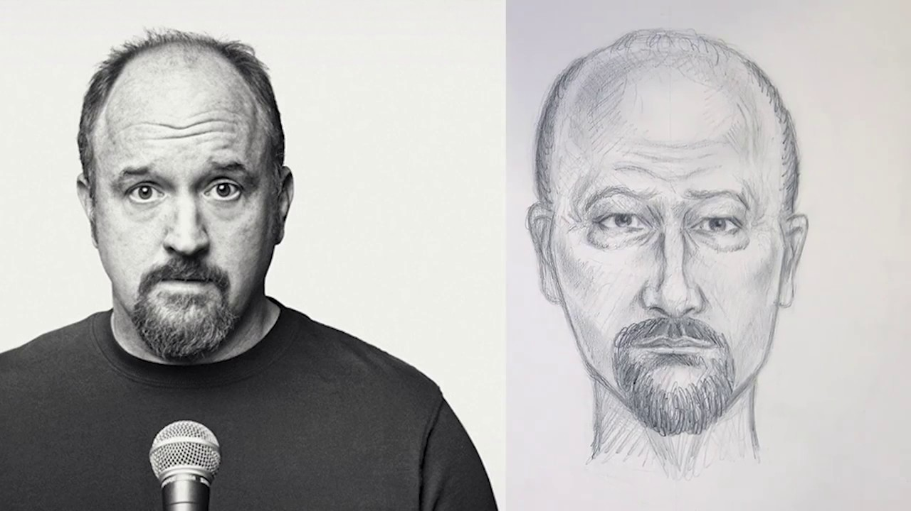
Description
Provide a software that improves the identification of criminal suspects
Natural Language/ Sketch
Images taken from city surveillance systems and online profiles
AI algorithms to build a 3D model of a suspect's face
Match the model against internal profiles
Help Federal and Local law enforcement agencies

Slide 3
Design Goals
NLAIFGML should be easy to use and understand, requiring minimal training to use.
The software should be able to connect to multiple external facial databases to use as long as the owner of the program has access to them.
Any data accessed or created by NLAIFGML should be as secure as possible.
The possibility of misuse of the program should be minimized.

Slide 4
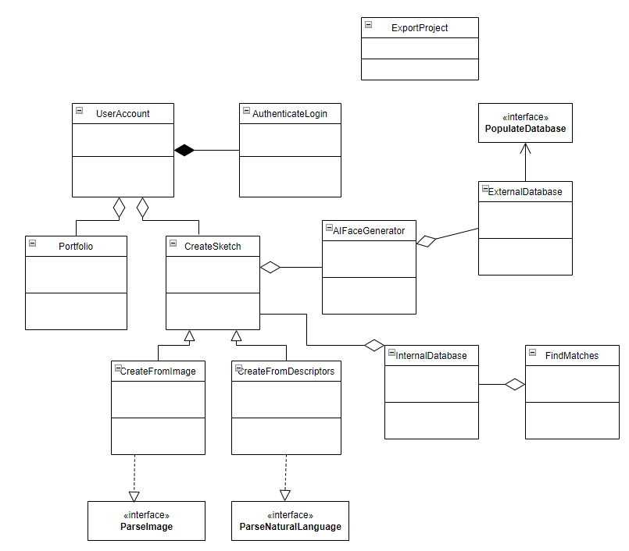
Initial System Design

Slide 5
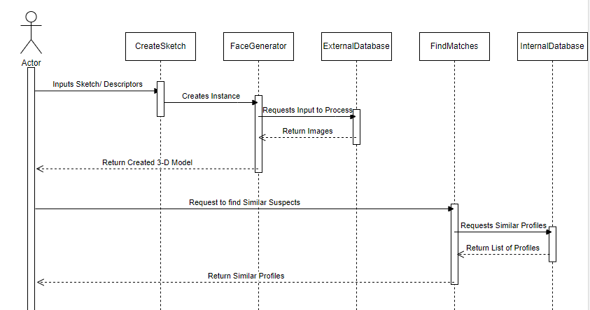
Find Similar Suspects

Slide 6
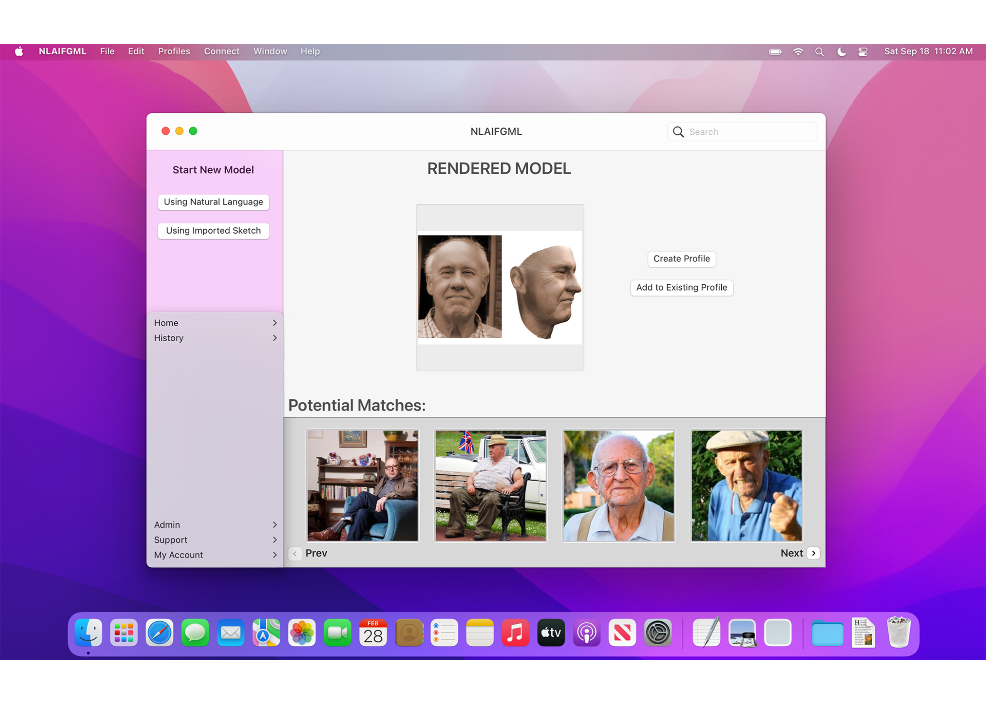
Mock-Up UI

Slide 7
Open Issues
Limitations of existing voice recognition technology
Might need to be developed further
Accuracy of 3D image generation from 2D images
Integration of databases

Slide 8
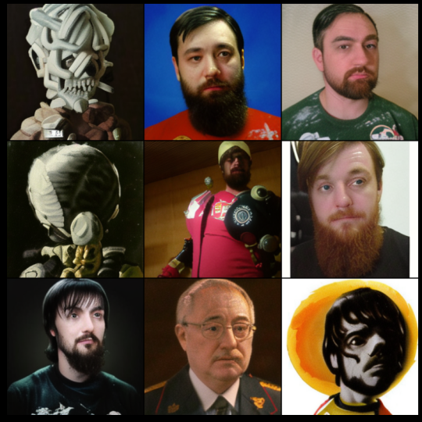
Off the shelf solutions
Looking Glass AI & Zoetrope 5
Image generation AI
Works with natural language descriptions
Existing facial recognition databases
Can be used to train the AI and as a library to generate different faces

Slide 9
Cost/Risk Analysis
Cost of Product v.s. Budget of Buyers:
Cost of product:
~20 Engineers, 5 years = $17.5 million
Cost of access to footage/image data
Cost of product may exceed many Crime Bureaucracies’ Budgets
Number of Buyers
Push-back from professional sketch artists
Resulting Effects on Crime-Solving Rate- will it make an impact?

Slide 10
Waiting Room and Solution Ideas
Waiting Room:
Connectivity to Neuralink
3D Holographic Display support
Solution Ideas:
Machine Learning: Existing Libraries such as PyTorch, TensorFlow
AI Face Generation: Rendering speed is important, preferably a custom rendering machine using C/C++, OpenGL, etc.

